Slide 1
WETA, tam a zase zpátky
Tomáš Davidovič

Slide 2
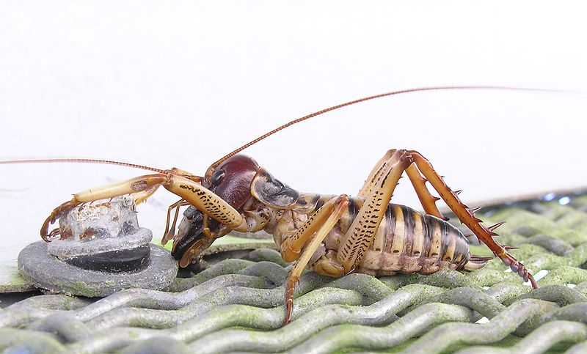
WETA

Slide 3

WETA Workshop

Slide 4

WETA Digital

Slide 5
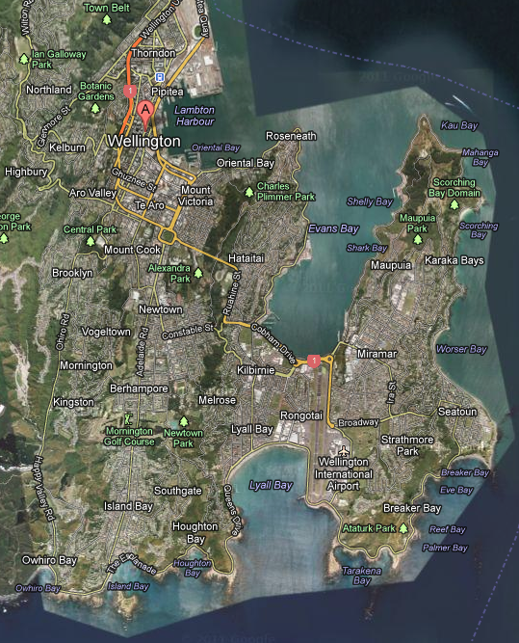
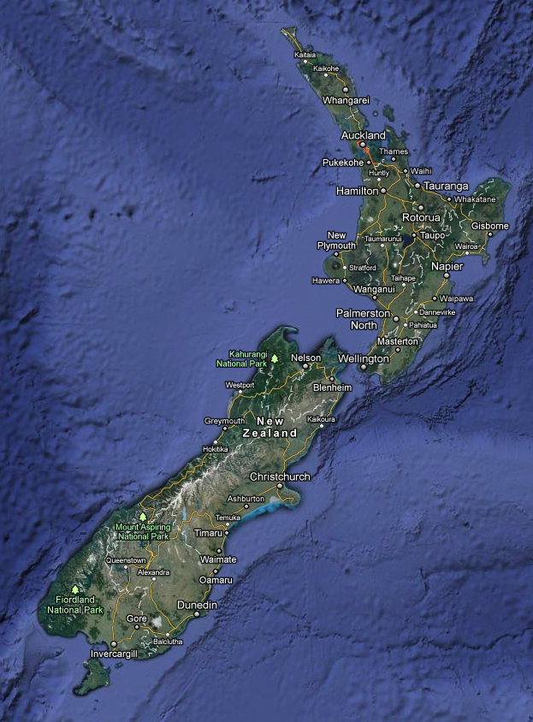
Wellington
WETA

Slide 6
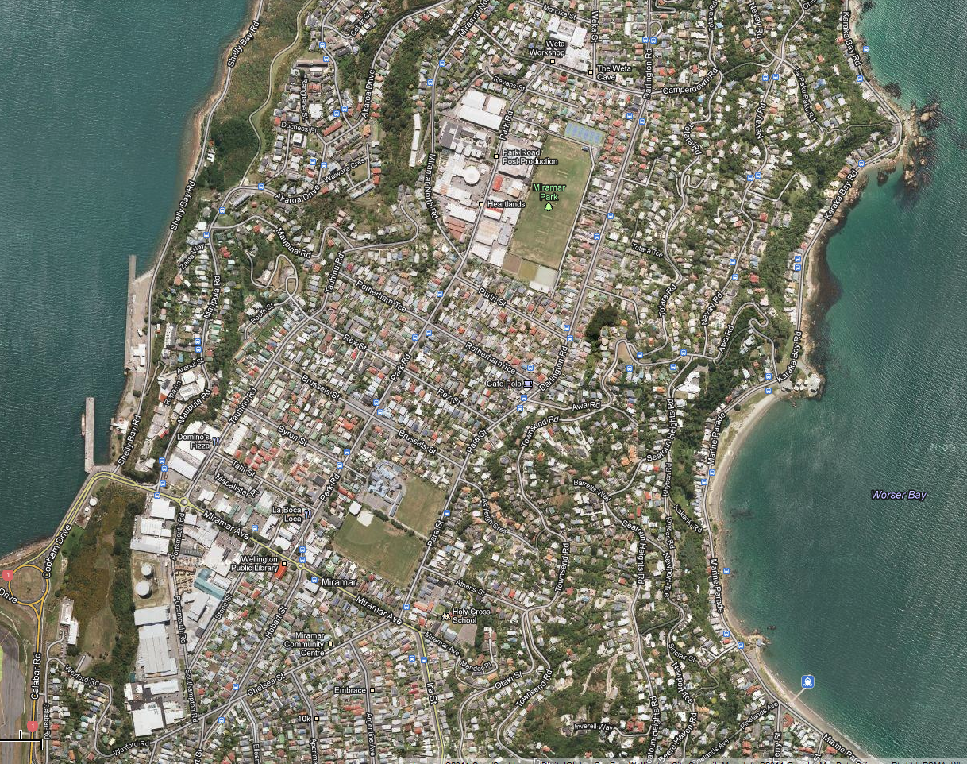

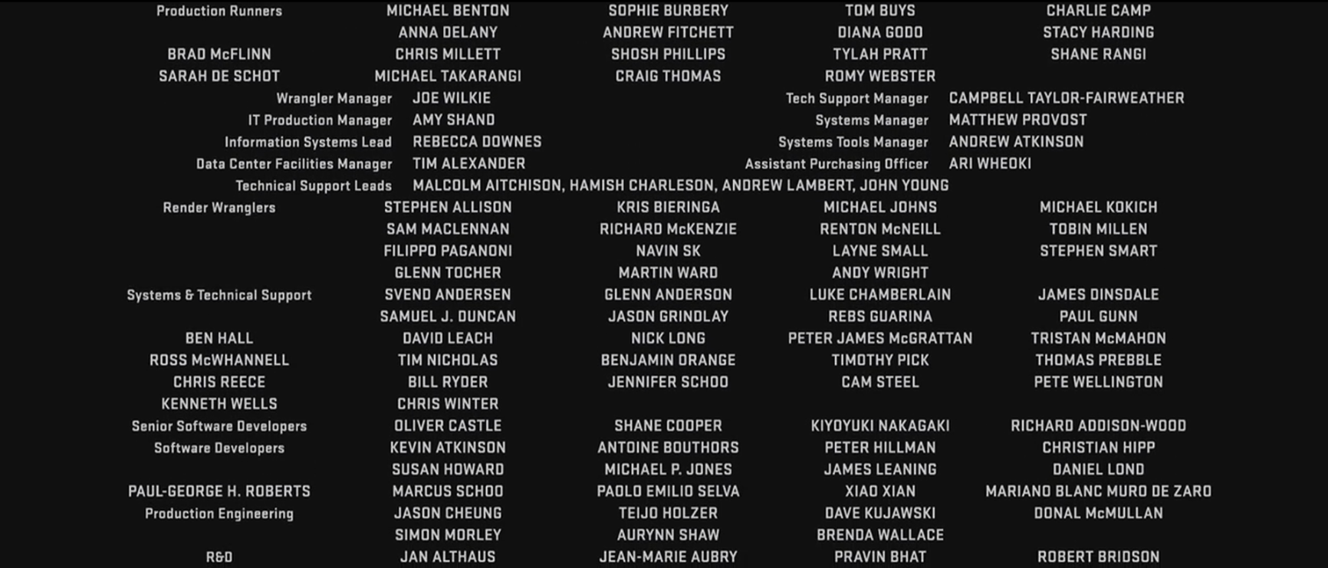
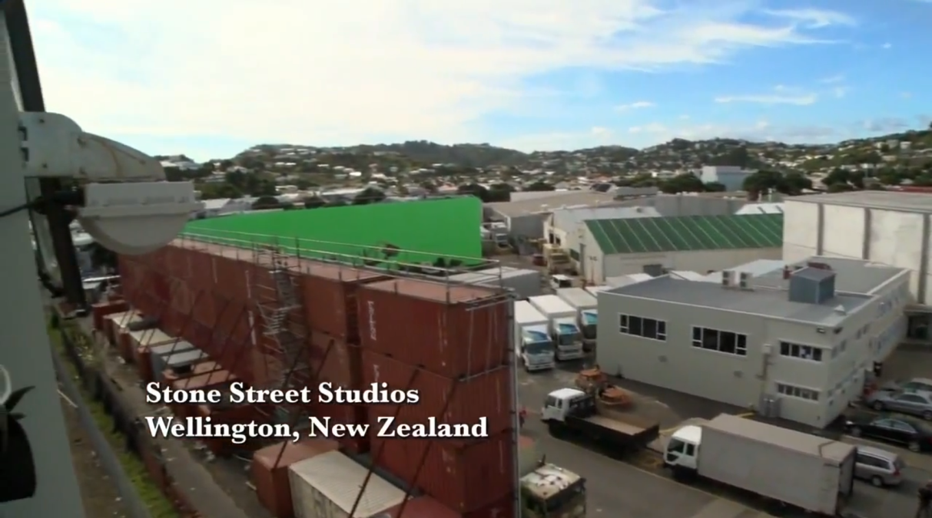

Slide 7
Wellington
WETA

Slide 8
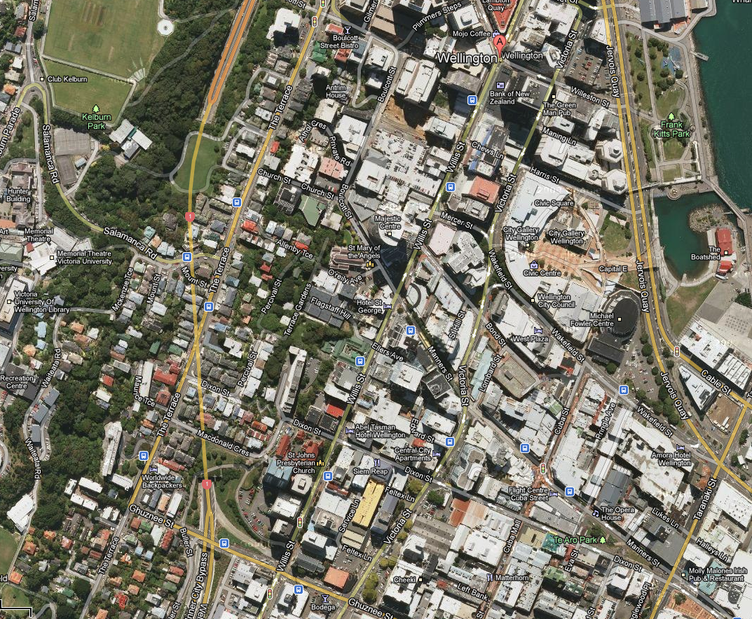

Slide 9
Wellington
WETA

Slide 10
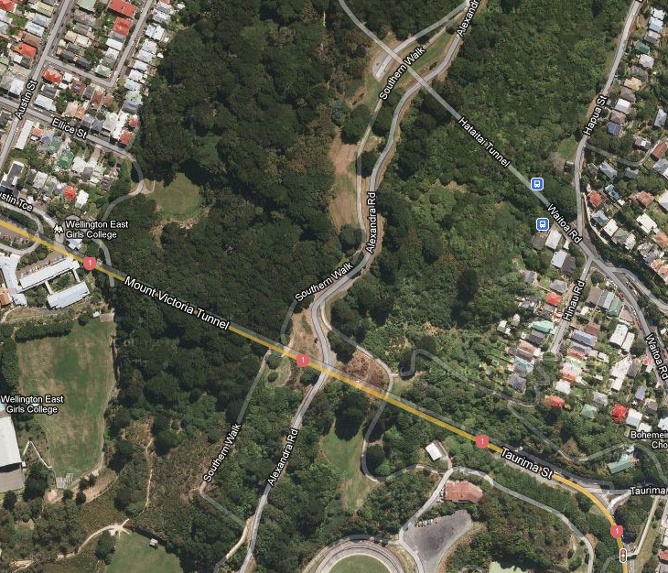

Slide 11
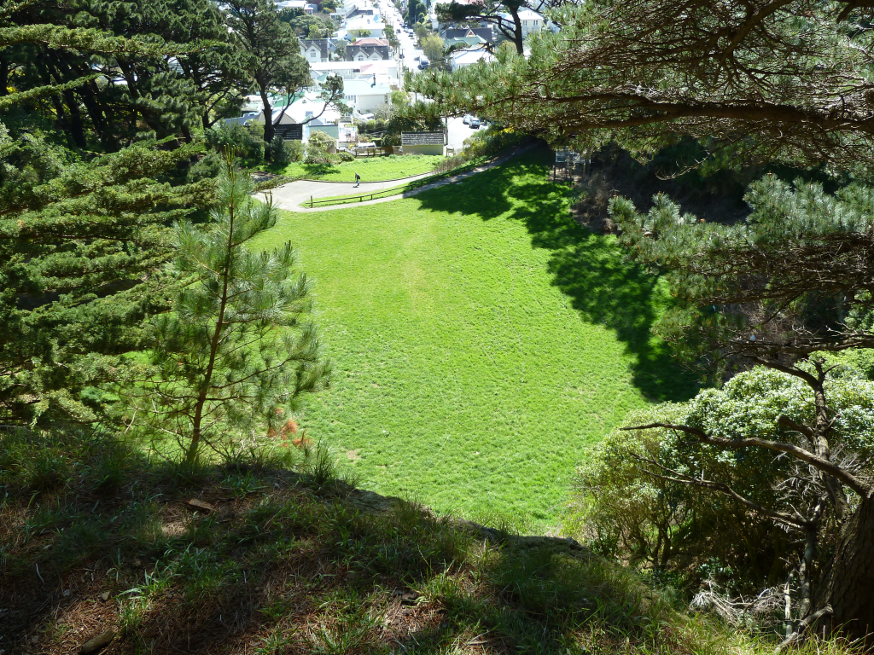

Slide 12
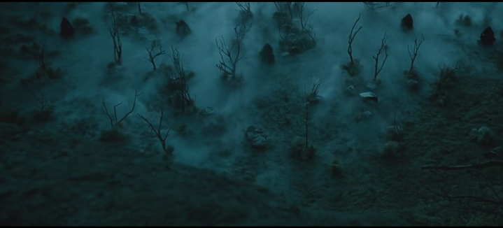

Slide 13
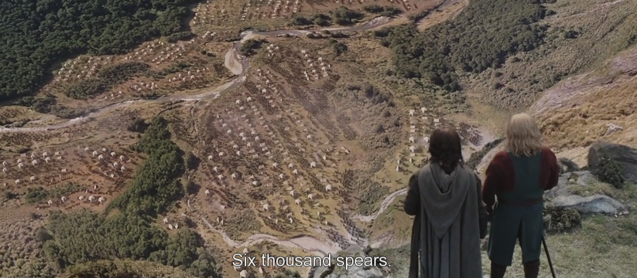

Slide 15
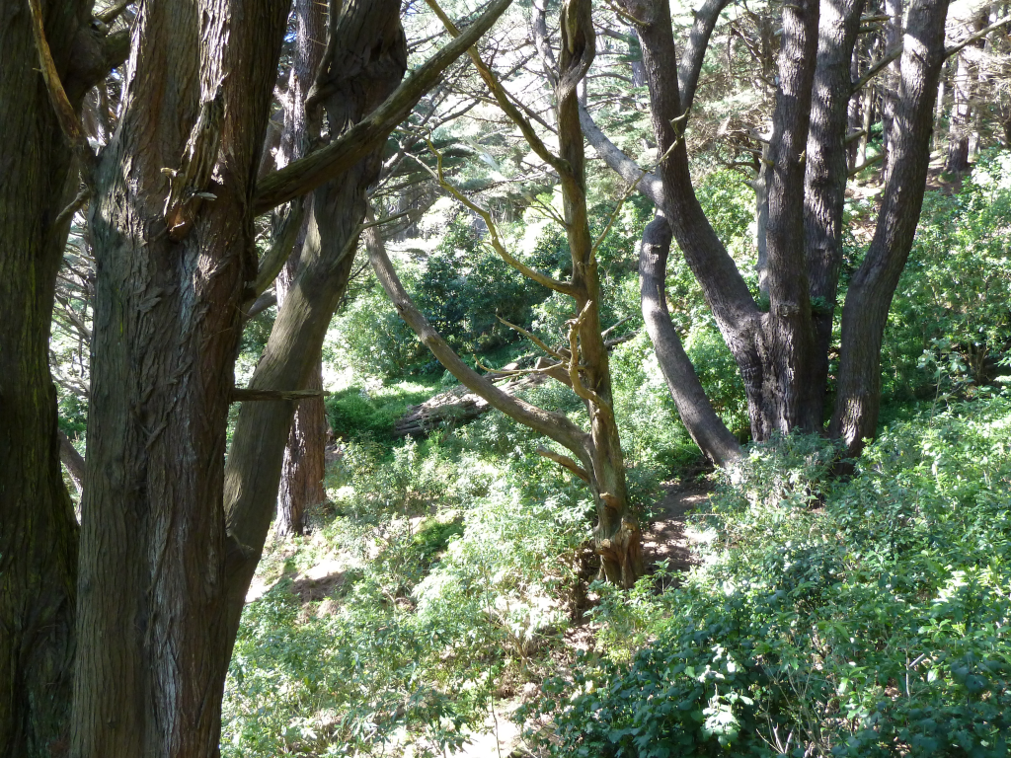

Slide 16
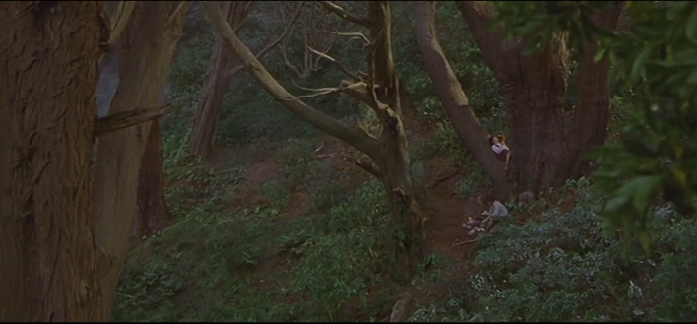

Slide 19
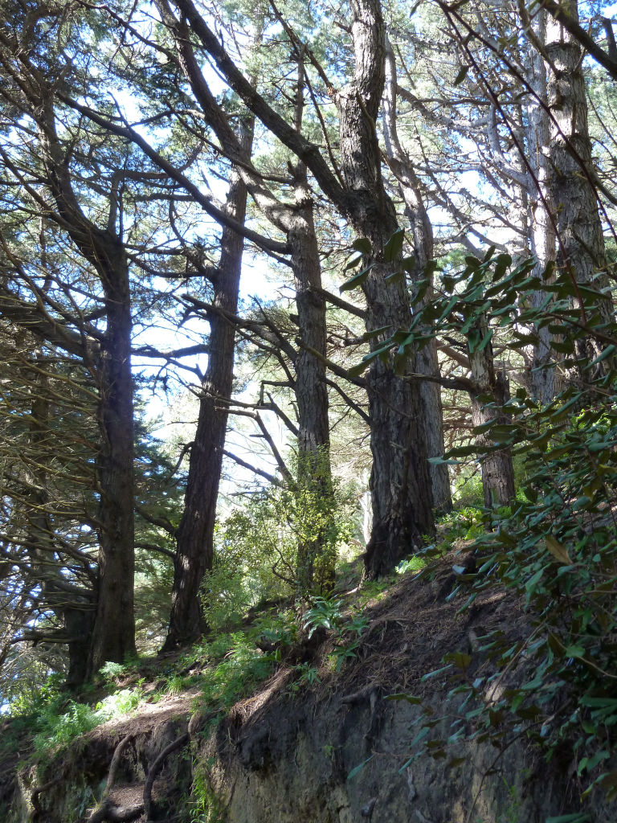

Slide 20
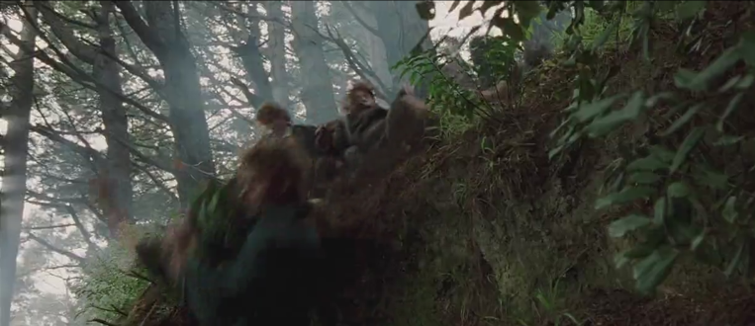

Slide 22
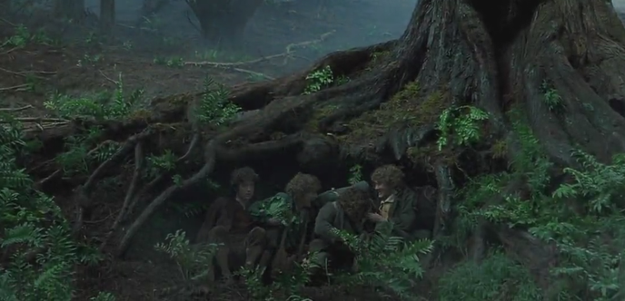

Slide 25
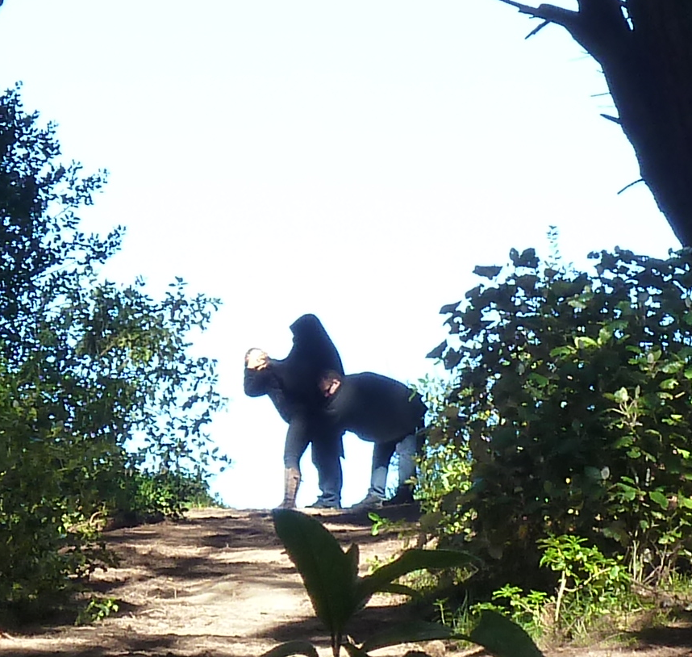

Slide 26
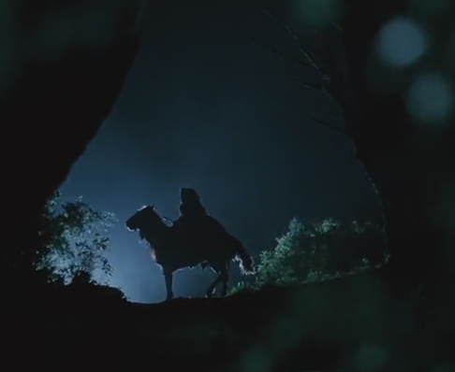

Slide 28
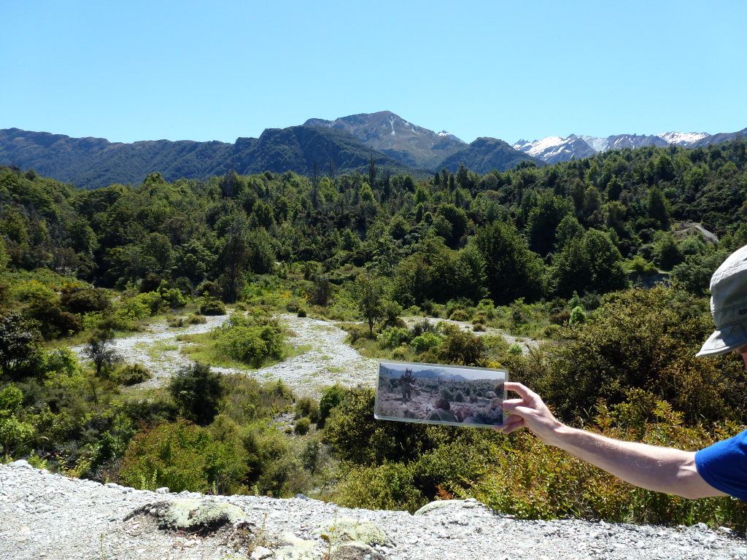

Slide 29
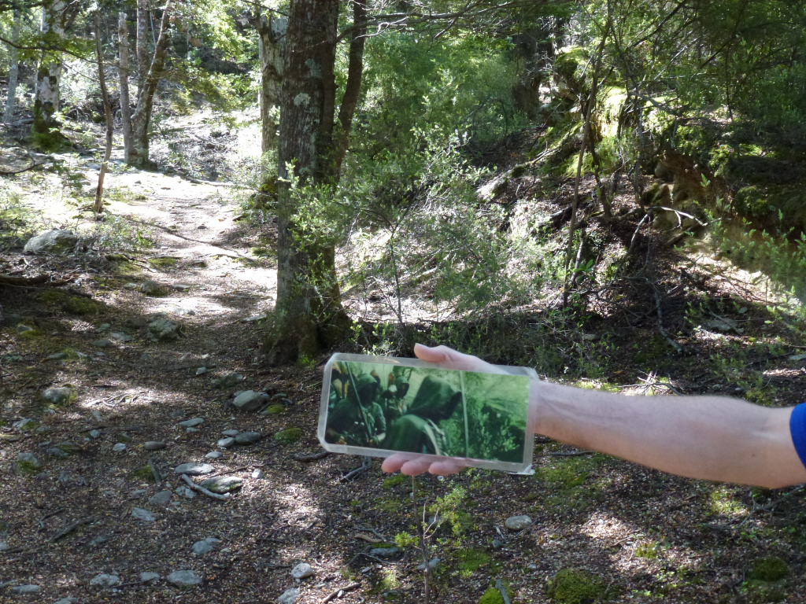

Slide 30
Pipeline – kéž by
Assets
3D
2D
Model
Animate
Light
Render
Comp
DI
Texture
Layout
Shade
Scan
Scan
Matchmove
Convert
Roto/paint

Slide 31
Pipeline – kéž by
Assets
3D
2D
Model
Animate
Light
Render
Comp
DI
Texture
Layout
Shade
Scan
Scan
Matchmove
Convert
Roto/paint

Slide 32
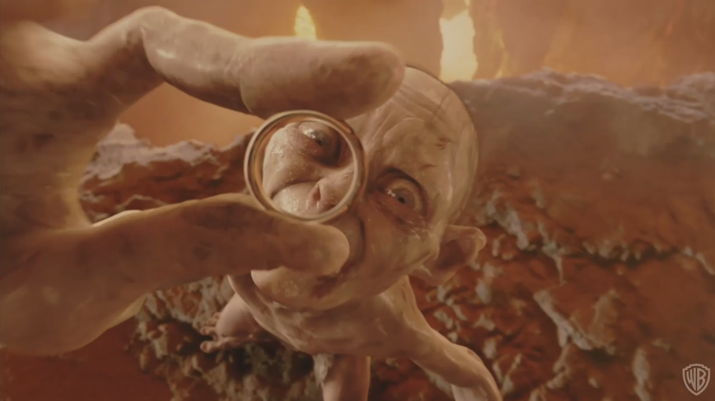
Assets – aktiva

Slide 33
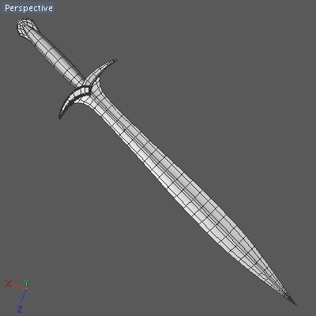
Assets

Slide 34
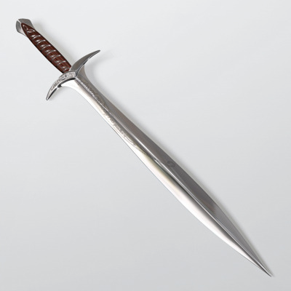
Assets

Slide 35
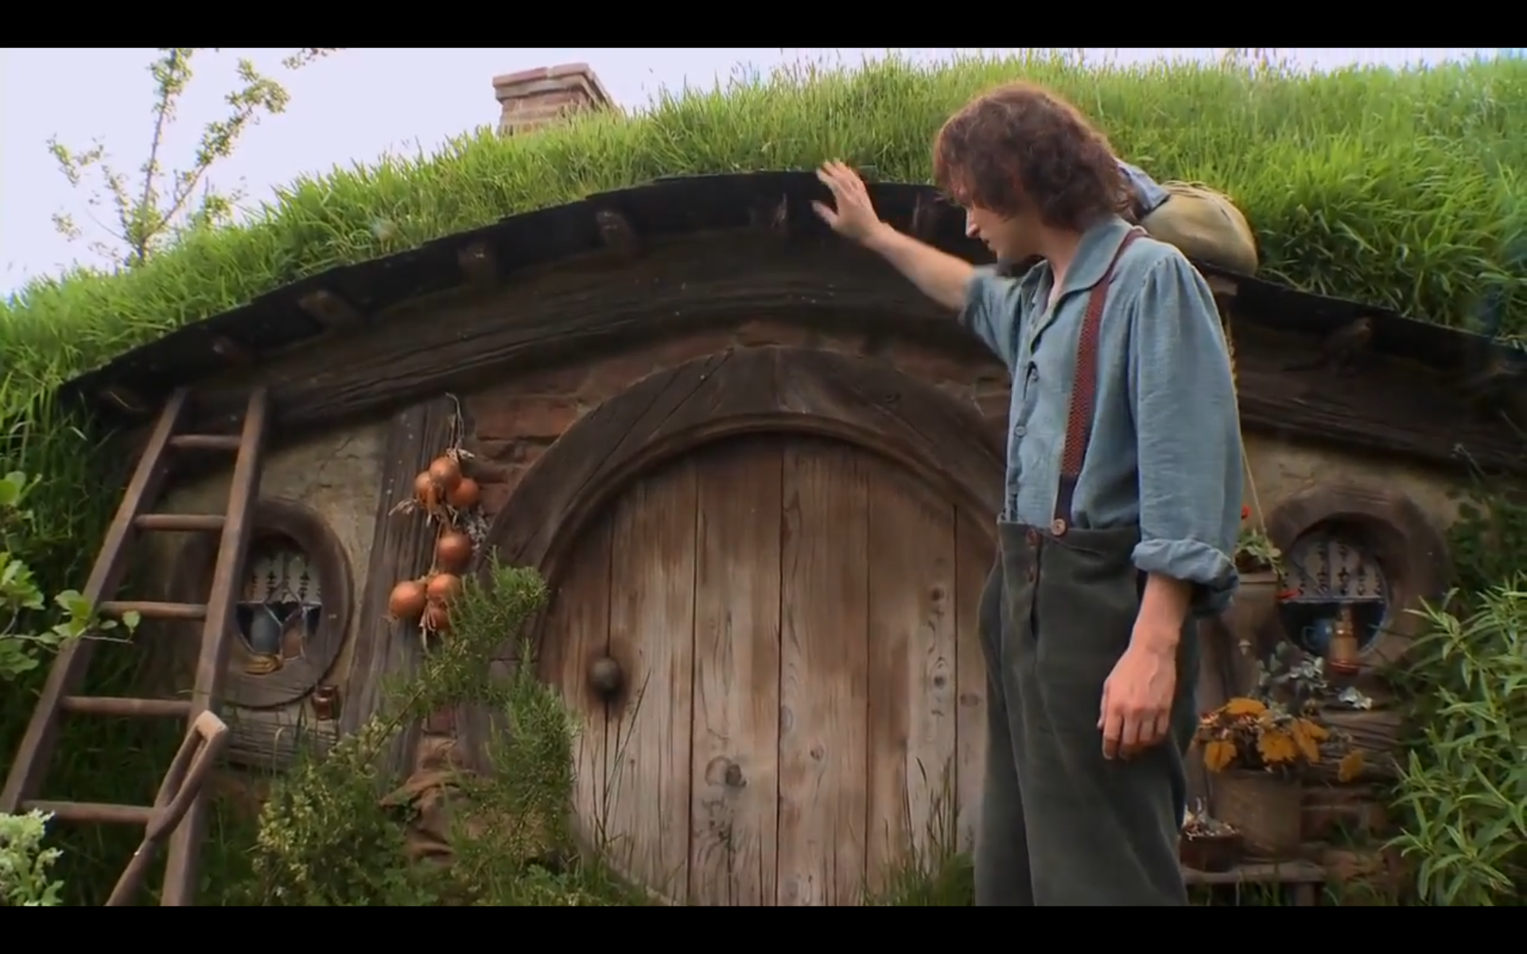
Hero assets

Slide 36
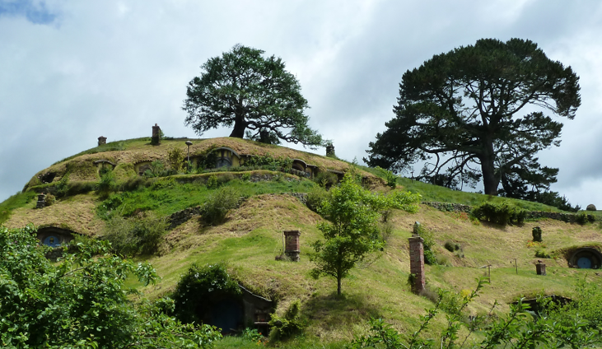

Slide 37
Pipeline
Assets
3D
2D
Model
Animate
Light
Render
Comp
DI
Texture
Layout
Shade
Scan
Scan
Matchmove
Convert
Roto/paint

Slide 38
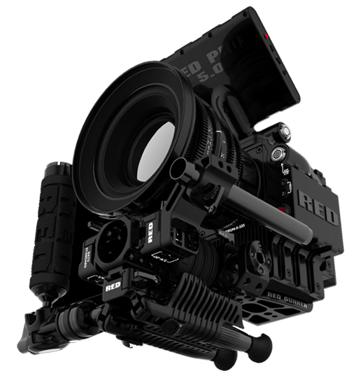
Red EPIC
5120 x 2700
120 fps
Two Exposures

Slide 39
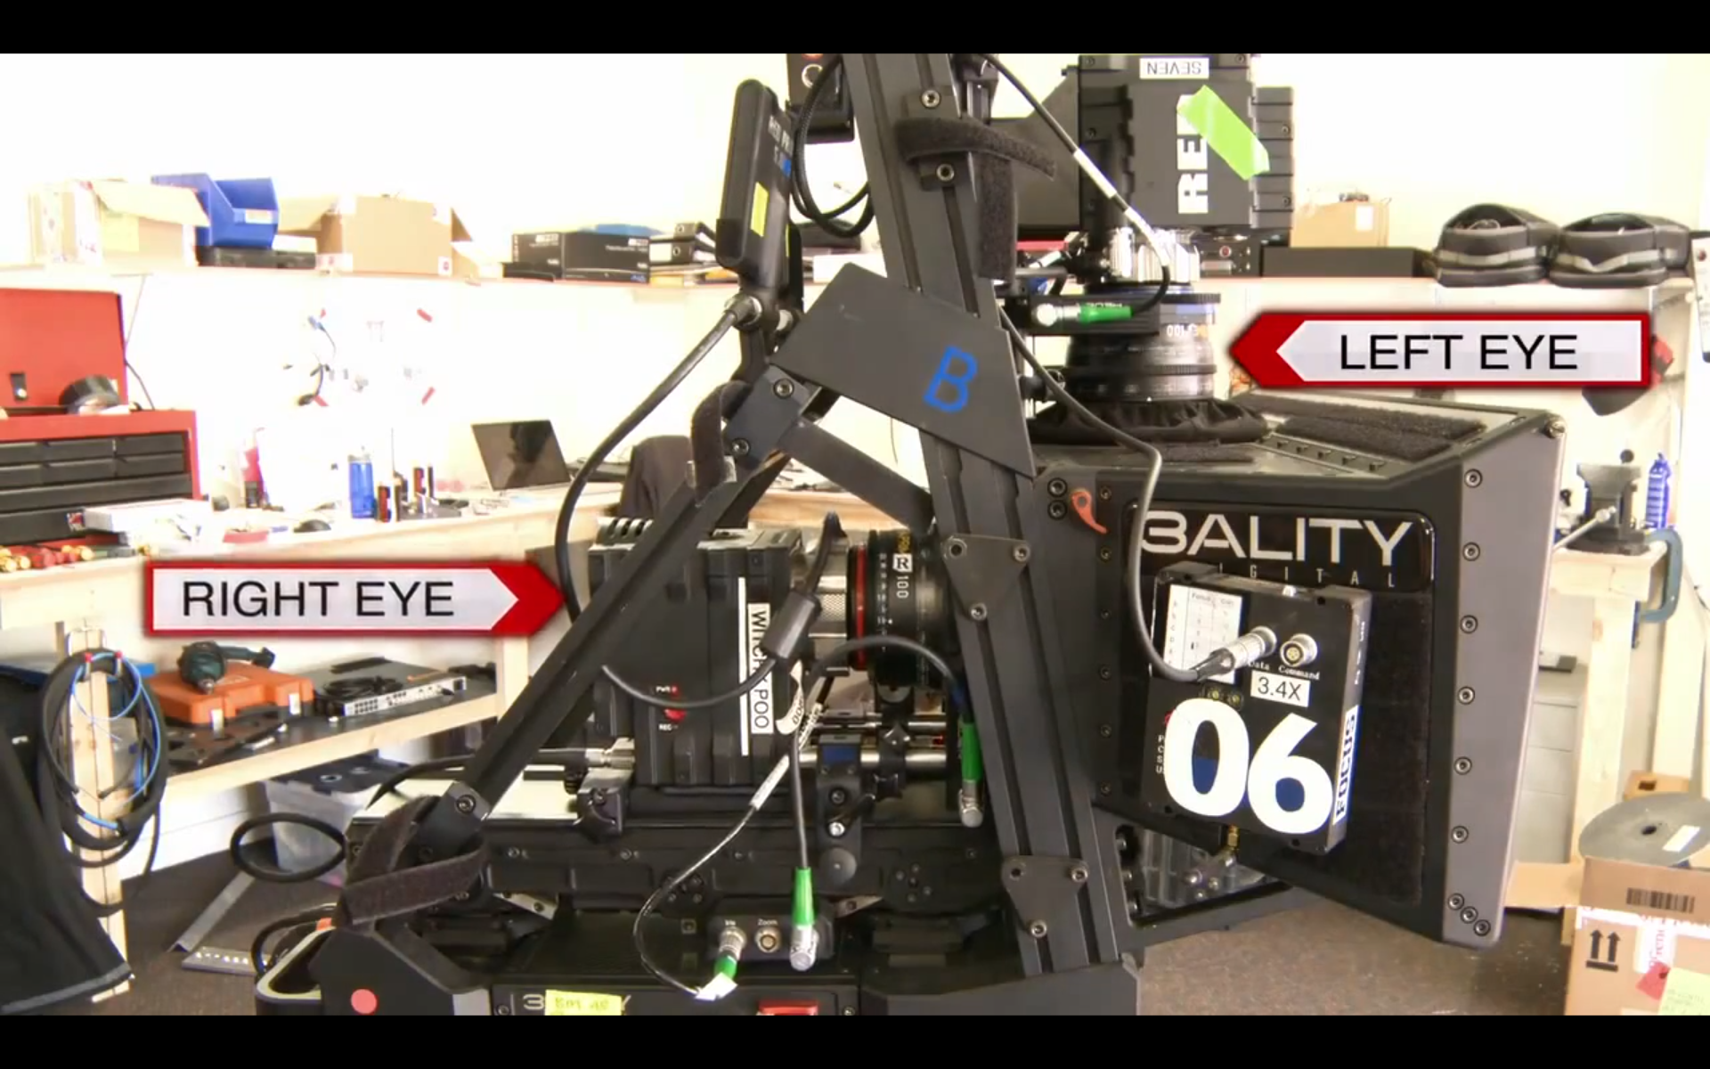

Slide 40
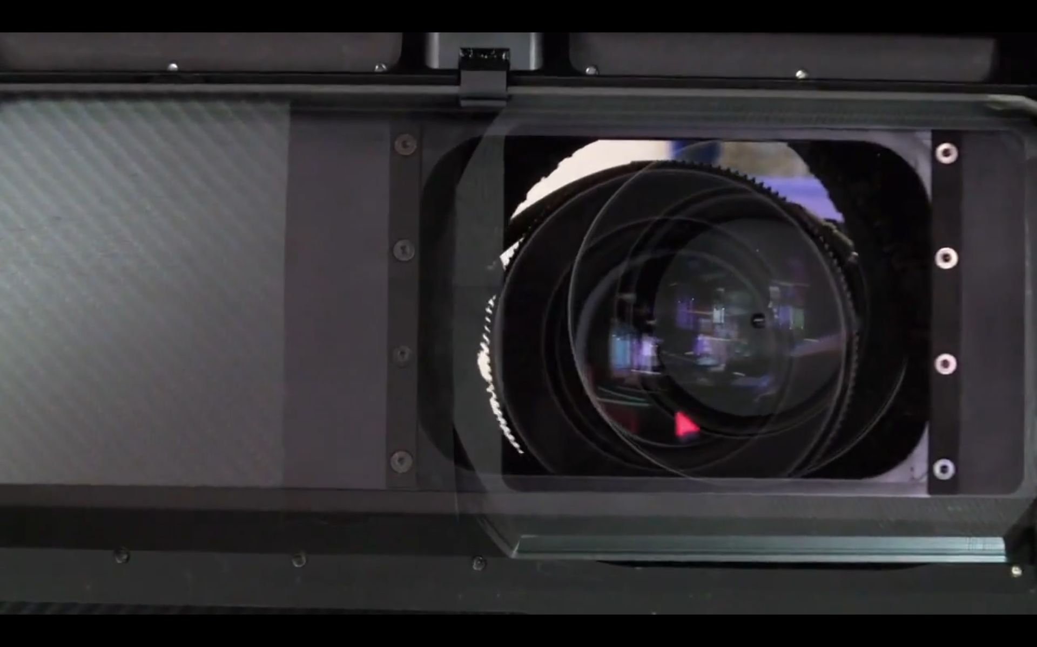

Slide 41
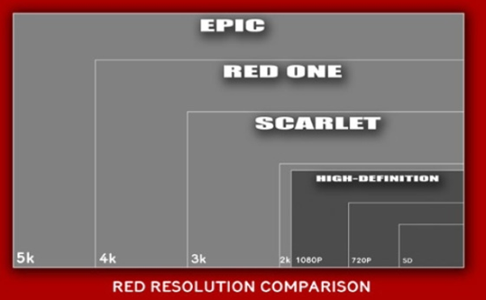

Slide 42
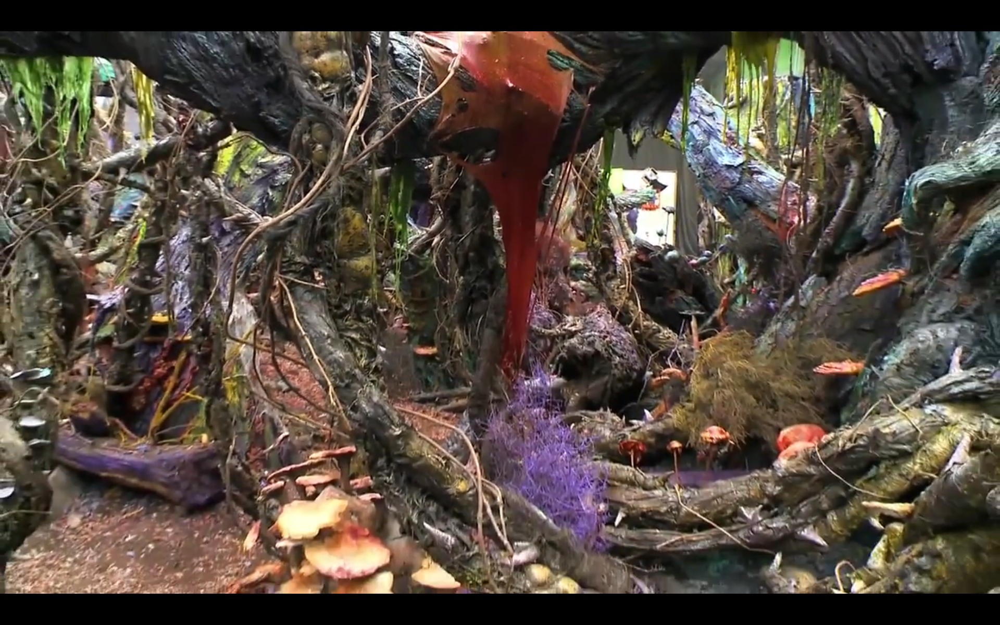

Slide 43


Slide 44
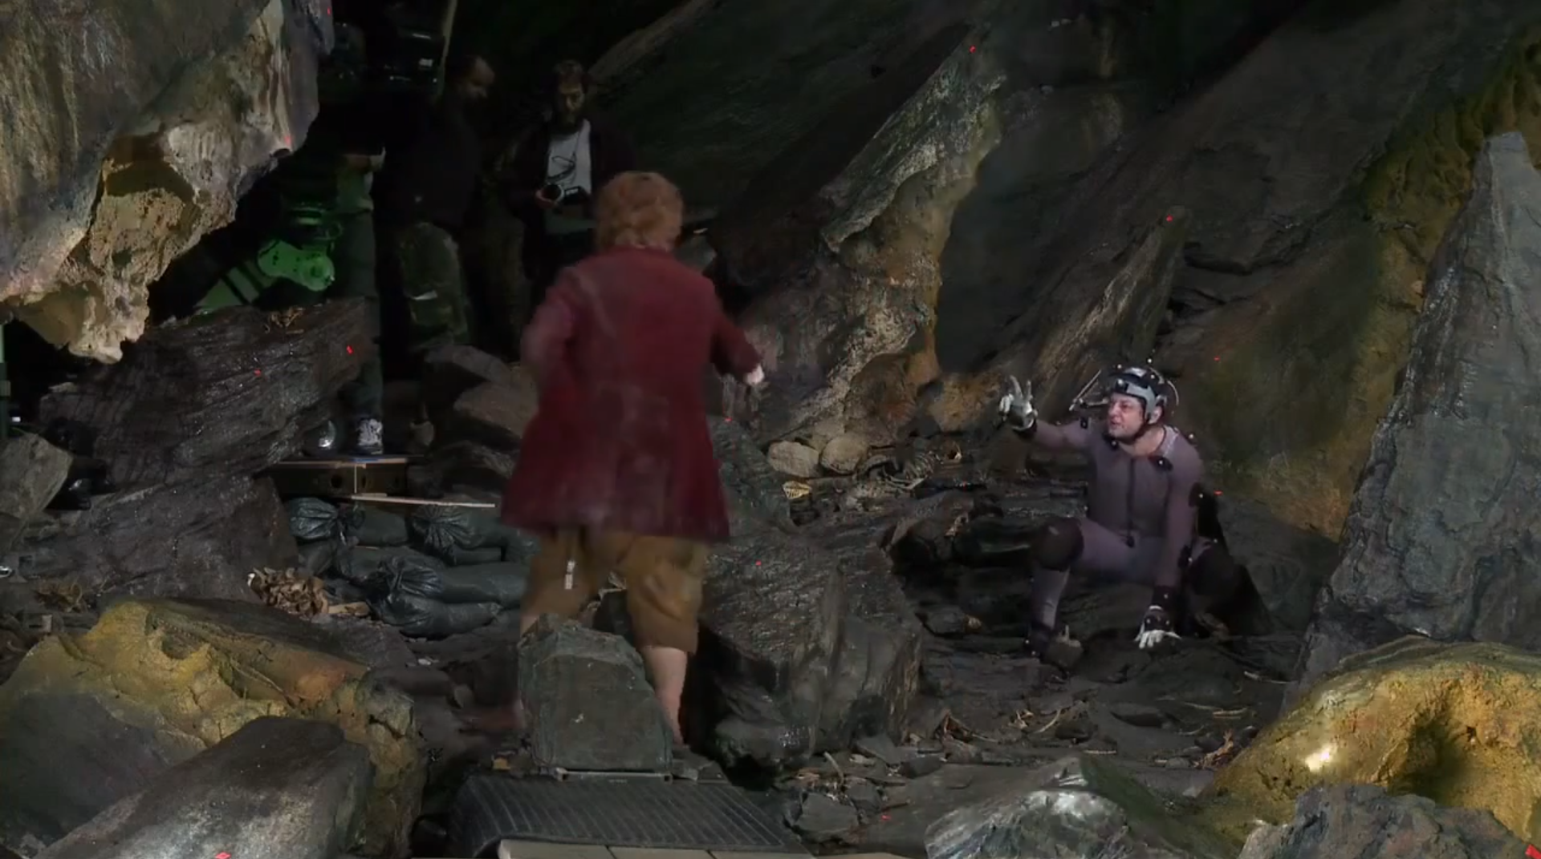
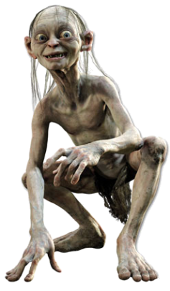

Slide 45
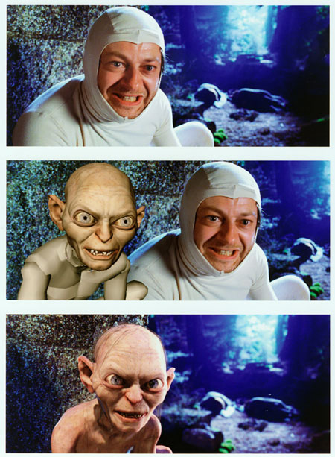
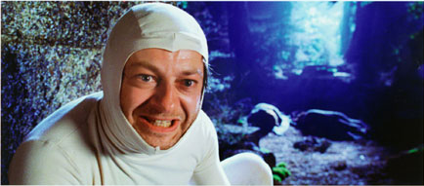

Slide 46
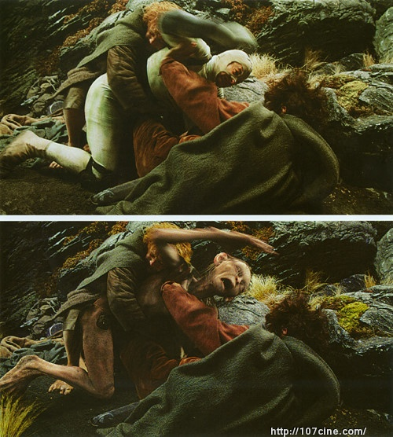

Slide 47
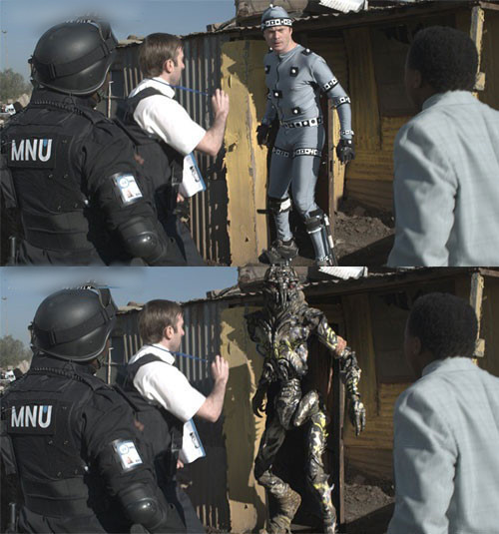

Slide 48
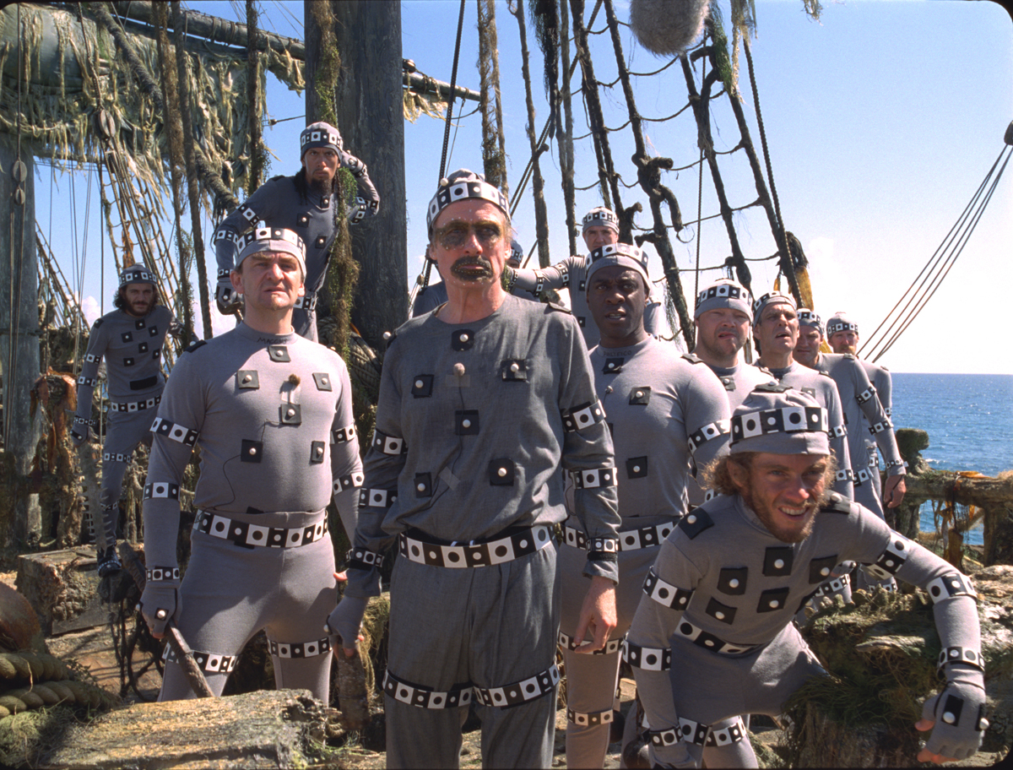
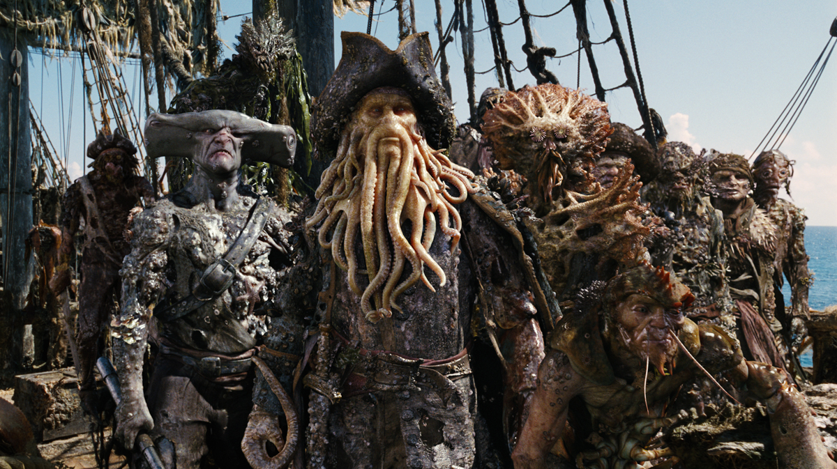

Slide 49
Pipeline
Assets
3D
2D
Model
Animate
Light
Render
Comp
DI
Texture
Layout
Shade
Scan
Scan
Matchmove
Convert
Roto/paint

Slide 50
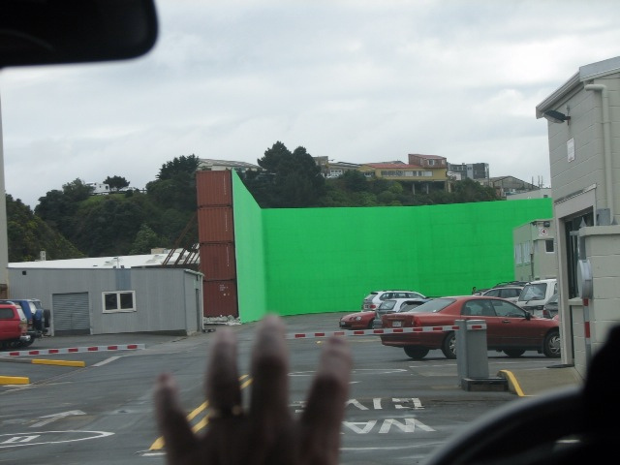

Slide 51
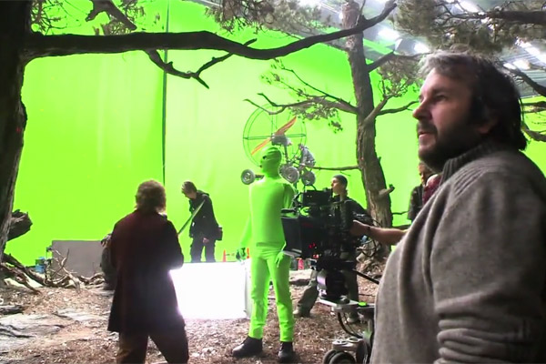

Slide 52
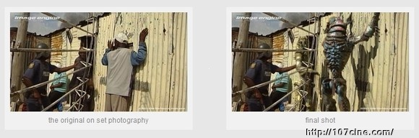

Slide 53
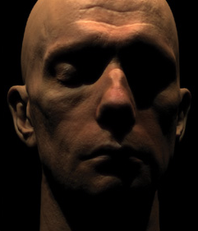

Slide 54
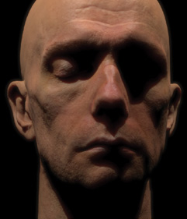

Slide 55
Pipeline
Assets
3D
2D
Model
Animate
Light
Render
Comp
DI
Texture
Layout
Shade
Scan
Scan
Matchmove
Convert
Roto/paint

Slide 56
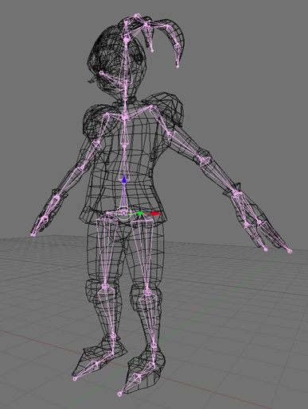

Slide 57
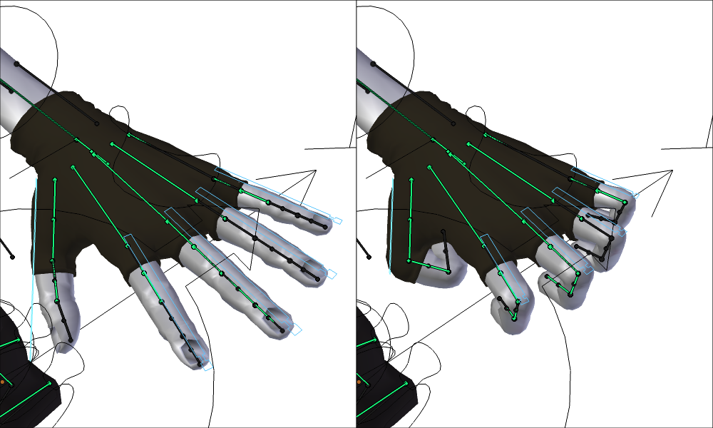
Animace – skinning

Slide 58
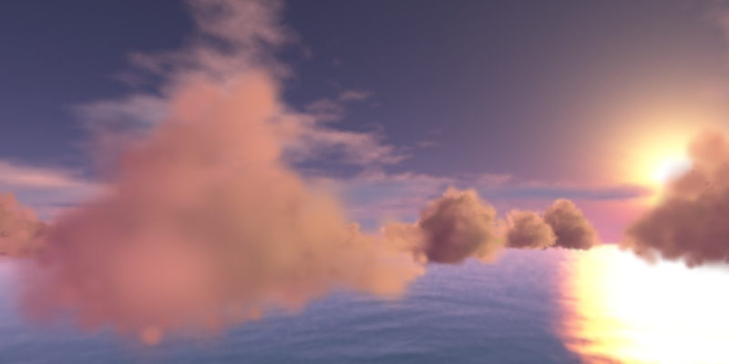
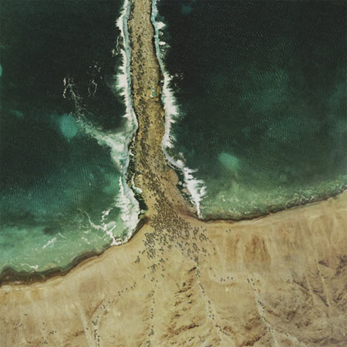
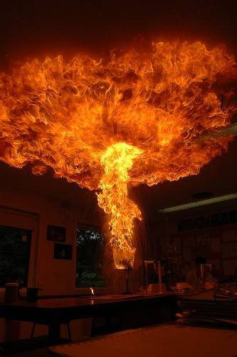
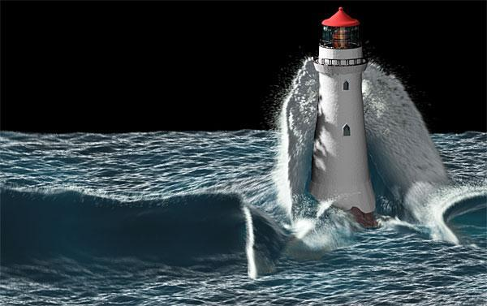
Animace – simulace

Slide 59
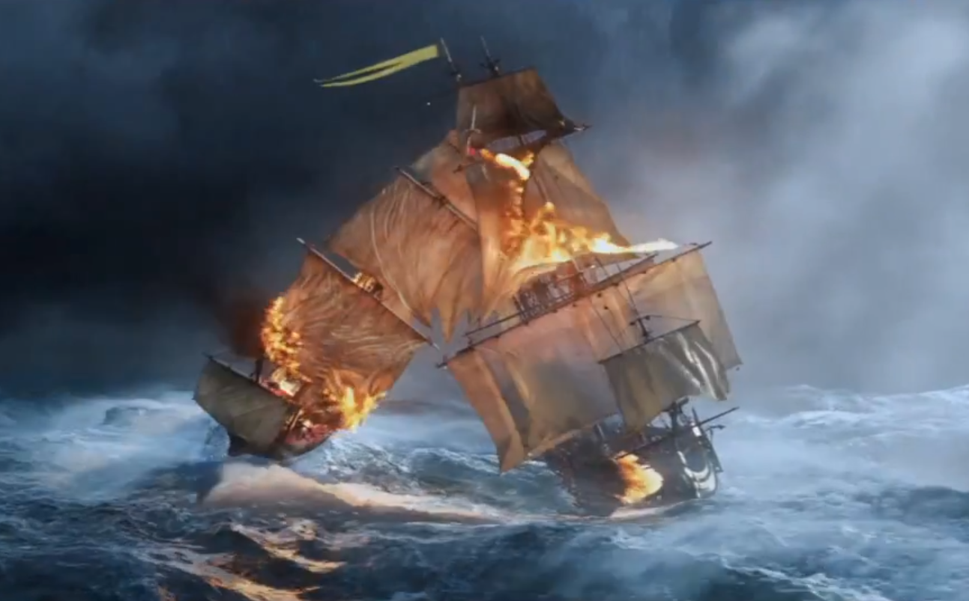
Layout

Slide 60
Pipeline
Assets
3D
2D
Model
Animate
Light
Render
Comp
DI
Texture
Layout
Shade
Scan
Scan
Matchmove
Convert
Roto/paint

Slide 61
Automatické kroky
Assets
3D
2D
Model
Animate
Light
Render
Comp
DI
Texture
Layout
Shade
Scan
Scan
Matchmove
Convert
Roto/paint

Slide 62


Světla
Erza Cornell
Cornell University

Slide 63
Světla

Slide 64

Světla – přímé osvětlení

Slide 65
Světla – přímé osvětlení

Slide 67



Slide 68



Slide 69






PhotoRealistic Renderman – všichni
Jurassic Park – 1993
Pirates… – 2006
Wrath of Khan – 1984
Geri’s Game – 1997
Avatar – 2009

Slide 70




Arnold Renderer – Sony
Cloudy with a Chance of Meatballs
Alice in the Wonderland
Monster House
2012

Slide 71


Slide 72


Slide 73


Slide 74


Slide 75




Slide 76


Slide 77



Slide 78


Top500 superpočítaců

Slide 79
Top500 superpočítaců

Slide 80


Slide 81


Slide 82


Slide 83


