Slide 1
Performance Considerations When Using a Dedicated Ray Traversal Engine
Tomáš Davidovič
L. Maršálek, P. Slusallek
Saarland University
In cooperation with IBM Boeblingen

Slide 2
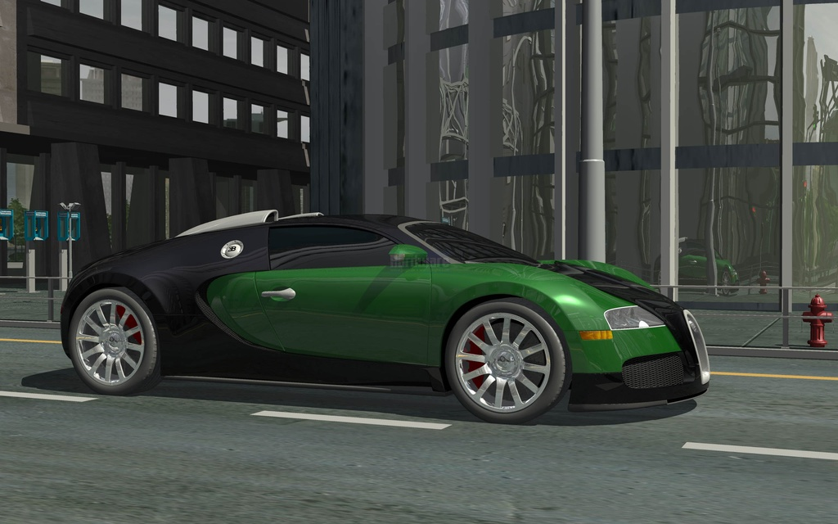
Ray Tracing vs Rasterization
NVIDIA – Bugatti Veyron
4x Quadro FX 4700 X2
8x G92
30 fps
Crytek – Crysis
1x GTX285
1x GT200b
~60 fps
Notes:
Let me start by pointing out why we should even want dedicated ray traversal engine.
At the top we see NVIDIA’s Bugatti Veyron demo. Running in full HD at 30fps, but it needs 4 Quadros, or 8 G92 cores.
Bellow that we see the game Crysis. Running on only single chip card, even though newer generation, it achieves at least the same FPS. And I would guess we can all agree that the overall impression from that image is better.
So, while both are running on the top notch GPUs, ray tracing is still missing some things. And I would like to talk about one of those.

Slide 3
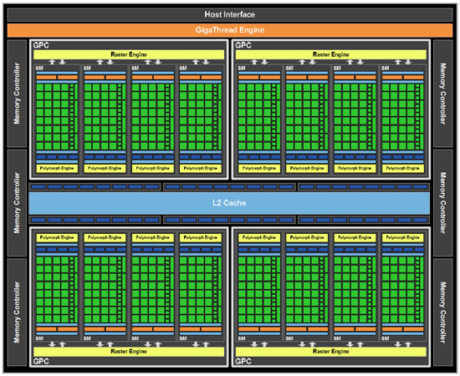
GPU decomposition
Fermi architecture
Fermi architecture slides by NVIDIA
Notes:
So lets look at the modern GPU, I picked the NVIDIA’s fermi for this.
We can see that it consists of several copies of the same block, so lets zoom out on one of them.

Slide 4
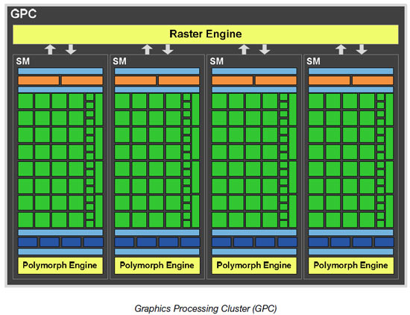
GPU decomposition
Fermi architecture
Registers &
scheduler
General
Purpose
cores
Texturing
Fermi architecture slides by NVIDIA
Tessellator etc.
Notes:
Here we see several units.
The polymorph engine takes care of tessellation and such.
Then we have texturing units.
General purpose cores that execute our shaders.
And registers and instruction scheduler, that supply data and drive the shaders.
So far, all of these are also useful for ray tracing.
So what is left is the raster engine.

Slide 5
GPU decomposition
Fermi architecture
Breaks triangles into fragments
Fragment generator
Replace raster engine with Ray Tracing Engine
Notes:
What does the raster engine do? For a given triangle and view, it creates triangle fragments for each pixel that it covers.
We might as well call it fragment generator.
And one we get rid of the “raster” in the units name, we realise we can replace it with any unit that will give us fragments. And fragment is nothing else than intersection point between a ray going through a pixel and triangle.
So we could replace the raster engine with ray tracing engine. And this is what we tried and the rest of the talk will be about the possible options and results.

Slide 6
Our Ray Tracing Engine
Basic information
Based on DRPU [Woop 2006]
64 threads, MT
32kB L1, 1MB L2
90 nm IBM process
2 GHz, < 15 mm²
45 nm, ~4mm²
Fermi, 530mm²
Main
memory
L2
Vertex
cache
Geometry
processor
Node
cache
Traversal
processor
Traversal
stack
IO unit
GP shaders
Notes:
We based our RTE on the DRPU by Sven Woop.
It utilizes hyperthreading with 64 threads running on the unit at once.
Has 32kB of L1 caches and 1MB L2 cache.
We took this and in cooperation with IBM used their proprietary 90nm process to synthesise this.
As result we got a unit that runs at 2GHz, and has below 15mm^2 area.
The results also suggested that with some modifications the unit run as high as 3GHz, but we have not investigate that more.
I would also like to point out that using very back-of-the-envelope scaling, the unit would have roughly 4mm^2 in 45nm process, and that the Fermi chip (done in 45nm) has over 500mm^2.

Slide 7
Our Ray Tracing Engine
Ray life cycle
GPU sends ray
Traverses to leaf
Access stack
Intersect triangle
Traverse further
Return result
Main
memory
L2
Vertex
cache
Geometry
processor
Geometry
processor
Node
cache
Traversal
processor
Traversal
processor
Traversal
stack
IO unit
GP shaders
Notes:
So, after the boring numbers, lets have a look at rays life in such a unit.
It starts by the GPU sending ray to the IO unit.
It passes it on to the traversal processor, that traverses ray through acceleration structure to a leaf.
During this traversal, it accesses the traversal stack.
Once in a leaf, geometry processor intersects the triangle with geometry.
Then the traversal continues on, and when the ray is done, the results are sent back.

Slide 8
Shader types – continuations
Description
GPU sends ray
Sleep until done
Continue
Like DRAM access
Cover 600 cycles
Needs compiler
Main
memory
L2
Vertex
cache
Geometry
processor
Node
cache
Traversal
processor
Traversal
stack
IO unit
GP shaders
Notes:
So, with this basic description, how do we map our ray tracer to utilize such unit?
The most straightforward way is to use shaders with continuations.
Here we have the trace function directly inside the shaders.
The way it then works is:
GPU sends the ray, sleeps until the ray tracing is done, and then continues with whatever operation depends on the ray.
This is very similar to accessing DRAM, and we know we can cover 600 cycle latencies quite nicely.
For practical usage, this kind of shader requires a compiler that will reorder the computations around the trace function.

Slide 9
Shader types – continuations
Results
MRays/s:
BW [GBps]:
L1 [%]:
L2 [%]:
Latency:
48.1
7.5
50.5
80.5
5.4M
Notes:
So lets look at some results.
We rendered 3 different scenes, from which I picked one.
Each scene had the primary rays, and then 16 ambient occlusion rays per pixel.
The ambient occlusion rays were very long, over 20% of the scene diameter, which is also reason why you see so much noise in this single frame image.
So lets have a look at the performance.
Our unit can trace just under 50 million rays per second. For comparison, probably the fastest GPU ray tracer, introduced by Aila et al. in 2009, can trace 150 million rays per second, but needs the whole GTX480 to achieve that.
Besides the pure throughput, we should also look at the bandwidth requirements, and at 7GBps, we are well within the capabilities of the modern GPU memory system.
The hit rate of our caches is 50 and 80% respectively, which is something we would like to improve.
And last statistic is latency. And here we can see it is nowhere near those 600 cycles we can easily cover.
Most of the latency comes from rays waiting for the unit to process them, as the single unit is somewhat of a hotspot on the chip. However, the ray tracing itself still takes about hundred thousand cycles.
So we can clearly see something has to be done here.

Slide 10
Shader types – tail recursion
Description
All shading done
GPU sends rays
Free for scheduling
Start new shaders
Ignores latency
Lower capabilities
Main
memory
L2
Vertex
cache
Geometry
processor
Node
cache
Traversal
processor
Traversal
stack
IO unit
GP shaders
Notes:
Lets have look at another way to write shaders, the tail recursion.
Here the shader finishes all its shading.
And as the last operation is fires off rays with all the required information attached.
So as soon as rays are sent to the unit, the shading hardware is free to process other shaders.
And once the rays are finished, they start new shaders that will process their new hitpoints.
The one big advantage we have is, that the unit effectively ignores latency. Nothing waits for particular ray result, so as long as there is some shading work to be done, the shading cores will be fully utilized.
The downside is, that the tail recursion has somewhat lower capabilities. Any adaptive sampling is pretty hard to do, and even something as simple as false color shading cannot be done in just one pass.

Slide 11
Shader types – tail recursion
Results
MRays/s:
BW [GBps]:
L1 [%]:
L2 [%]:
Latency:
52.3
6.2
59.5
78.5
5.0M
Notes:
But for most of the applications we are interested in it is sufficient, so lets have a look at the results.
We can see that just by using the tail recursion, we actually increased the throughput, lowered bandwidth and increase the L1 hit rate. All of these are connected and caused by the different and more coherent order the rays come in when compared to continuation shaders.
We can also see that the L2 cache hit rate dropped a bit, but as long as L1 is grows we don’t really mind.
And last but not least, the latency actually dropped. So not only can we essentially ignore it, it is actually lower.
But, we thought that the L1 hit rate could still be improved upon.
And given a fixed size cache, the process does not really scale with the size of the scene all that well.

Slide 12
Using treelets
Towards cache coherency
Architecture Considerations for Tracing Incoherent Rays
[Aila and Karras 2010]
Each treelet fits into cache
Notes:
To address a similar issue on GPU ray tracer, Aila and Karras introduced the concept of treelets. They split the acceleration structure into chunks, treelets, that fit into the cache, and then traverse these treelets in a cache coherent way.

Slide 13
Using treelets
Description
Rays in queues
Pick a queue
Traverse treelet
Store rays
Intersect triangle
Return result
Main
memory
L2
Vertex
cache
Geometry
processor
Geometry
processor
Node
cache
Traversal
processor
Traversal
processor
Traversal
stack
IO unit
GP shaders
Notes:
So how would that work in our framework.
The rays are stored in queues, one queue per treelet.
We pick the largest treelet (the one with most rays).
We traverse each ray in the queue through the treelet.
When ray reaches the treelet boundary, it is stored in the queue corresponding to the treelet if wants to traverse next.
Of course, we still intersect triangles when rays reach them, and once the ray is done its result is returned.

Slide 14
Tail recursion with Treelets
Results
MRays/s:
BW [GBps]:
L1 [%]:
L2 [%]:
Latency:
64.4
4.4
92.5
67.0
28.7M
Notes:
As this requires many rays to be effective and increases latency, we present only the results when paired with the tail recursion.
The throughput went to 64 million rays per second, so we have over 20% increase over the initial idea. The bandwidth dropped further down, which is easily explained by the significantly higher hit rate of L1 cache. The L2 cache hit rate went further down, but given the overall results we don’t care all that much.
The most scary number here is the latency, which rocketed to almost 30 million cycles. But if we have reasonable amount of rays per pixel to keep the shaders busy, this is not an issue for tail recursion shaders.

Slide 15
Results
Overview
Cont.
Tail rec.
+Treelets
MRays/s:
BW [GBps]:
L1 [%]:
L2 [%]:
Latency:
48.1
7.5
50.5
80.5
5.4M
52.3
6.2
59.5
78.5
5.0M
64.4
4.4
92.5
67.0
28.7M
Notes:
So to give overview of the results, we showed the continuation shaders, which give reasonable throughput, but have low cache hit rates and latency that is simply not acceptable for this kind of shading.
Next we showed tail recursion, that can ignore latency, but while it improved some on the memory hit rates, we showed that we can do significantly better by combining the approach with treelets.
This combination gives us the best throughput, and even though it has really scary latency, it does not really mind it due to the usage of tail recursion.

Slide 16
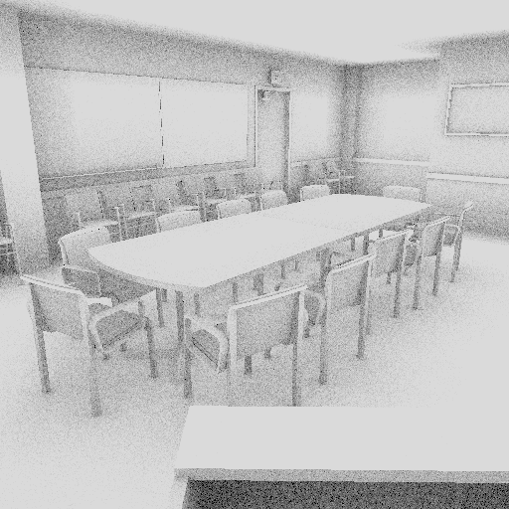
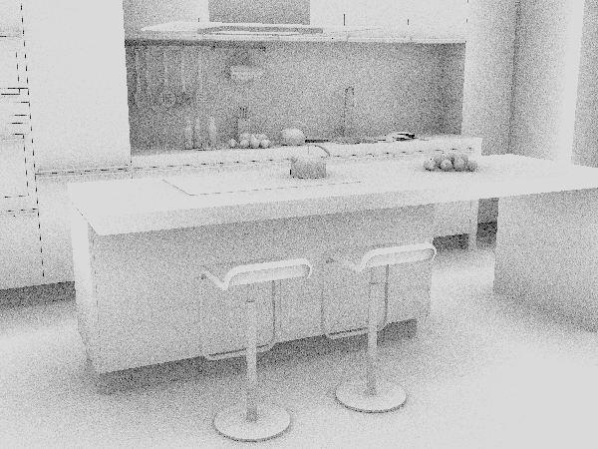
Results
Overview
MRays/s:
BW [GBps]:
L1 [%]:
L2 [%]:
Latency:
112.8
2.8
95.0
67.0
15.4M
96.7
2.5
96.5
66.0
23.7M
64.4
4.4
92.5
67.0
28.7M
Notes:
Of course, we tested no only on the fairy forest, but on two more scenes.
As you can see, the other two scenes perform actually better than the fairy forest, with throughput around 100 million rays per second, higher hit rates, and lower bandwith and latencies

Slide 17
Conclusions & future work
Dedicated ray tracing engine
Running at:
2 GHz, 60-100 MRays/s, under 7 GBps bandwidth
Optimal performance:
Tail recursion, Treelets
Future work
Multiple RTE on chip
16x RTE; 1.6 BRays/s
Notes:
To conclude, we introduced a dedicated ray tracing engine running at 2GHz, with throughput of 60-100 million rays per second and under 7GBps bandwidth.
From the tested configurations we deem the tail recursion with treelets to be the optimal one.
For the future work we would like to examine possibility of having not just one, but multiple RTE on a single chip. Giving each multiprocessor its own RTE would cost under 10% of the chipt area and provide us with 1.6 billion rays per second.

Slide 18
Acknowledgements
IBM research – Boeblingen
German Research Foundation (Excellence Cluster 'Multimodal Computing and Interaction‘)
Notes:
I would like to thank the following institutions for their support

Slide 19
Tomáš Davidovič
Notes:
And thank you for your attention

